Slide 1


Banking Customer Churn Prediction Using Machine Learning
Leveraging Microsoft Azure ML for Customer Retention
by Priyal Rawat

Slide 2

Problem Statement
1
Critical Challenge
2
Manual Monitoring
Customer churn affects revenue and retention.
Difficult to predict churn in time.
3
Data-Driven Solutions
Microsoft Azure ML for Customer Retention

Slide 3
Literature Review
Churn Drivers
Challenges in Prediction
ML Techniques & Gaps Addressed
Service fees, poor customer experience, and availability of alternatives are key drivers of customer churn. (Datrics AI, 2023)
Lack of real-time integration and sentiment analysis capabilities pose challenges in churn prediction. (Pahul Preet Singh & Fahim Islam Anik, 2023)
ML models like Decision Tree, Random Forest, Gradient Boosting, and Logistic Regression. (Keldine Malit, 2018)
Logistic Regression offers simplicity & transparency. (Hoang Tran, 2023)

Slide 4

Methodology
Dataset
Key Features
Bank Customer Churn Dataset (Kaggle).
Demographics, financial data, engagement metrics.
Preprocessing
Model Development
Handled missing values, categorical value.
Logistic Regression Model & Model Comparison
Feature Selection: Credit Score, Age, Balance, Products Used, Active Membership.

Slide 5

Hypothesis Testing
1
Higher Balances
Less likely to churn
2
More Products
Lower churn rates
3
Active Members
Churn less frequently
4
Higher Credit Scores
Lead to lower churn

Slide 6
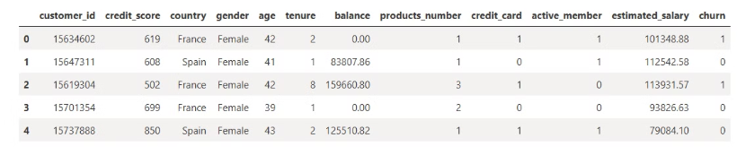
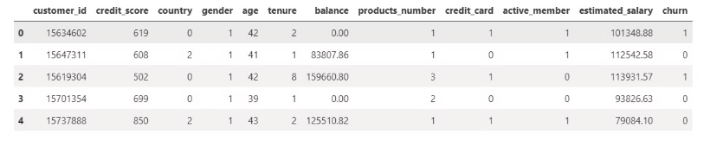
Data Overview and Data Preprocessing
Dataset Overview
Data Preprocessing: Converting categorical variables into numerical

Slide 7
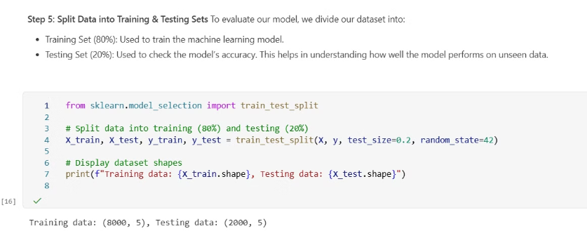
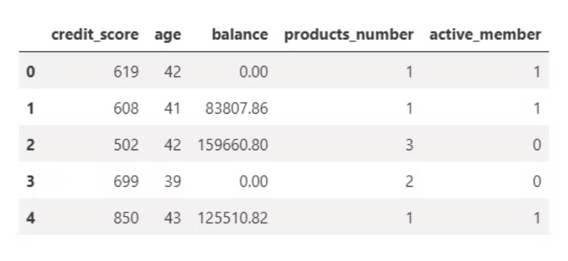
Feature Selection & Model Training
Feature Selection for Model Training
Model Training: Training data (80%) & Testing Data (20%)

Slide 8
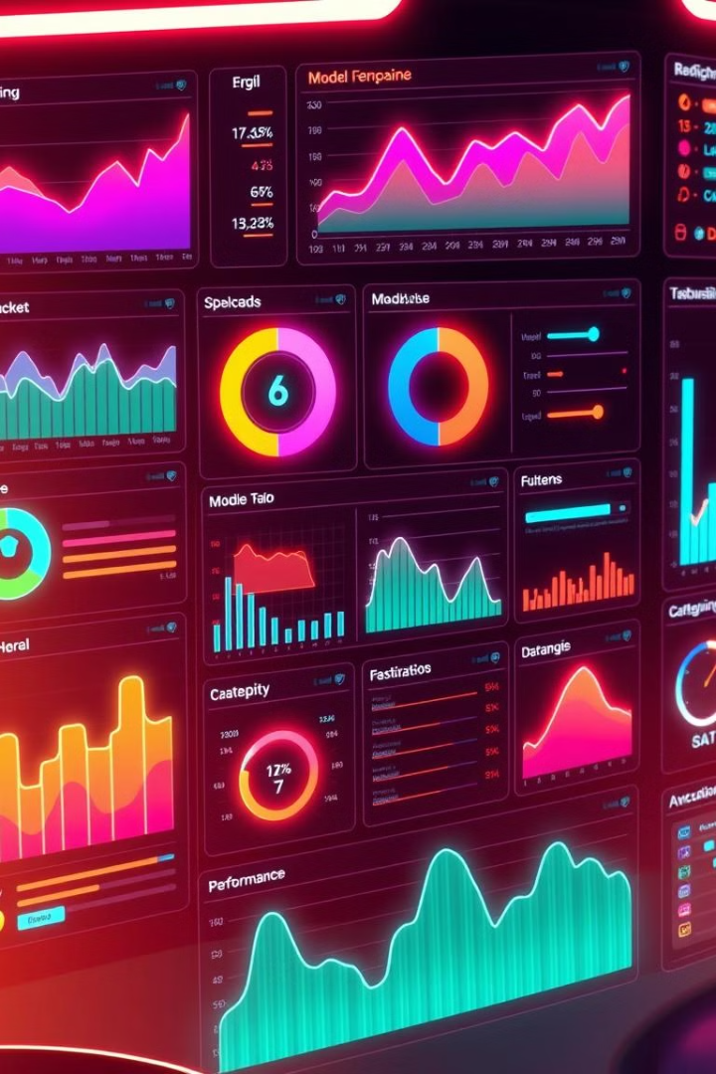




Model Performance (LR)
Accuracy
81%, strong predictive capability.
Non-Churned
High precision (82%) and recall (97%).
Churned
Low precision (56%) and recall (16%).
Final Churn Prediction & Model Validation
Results displayed in tabular format, verified accuracy and effectiveness of the model’s predictions.

Slide 9
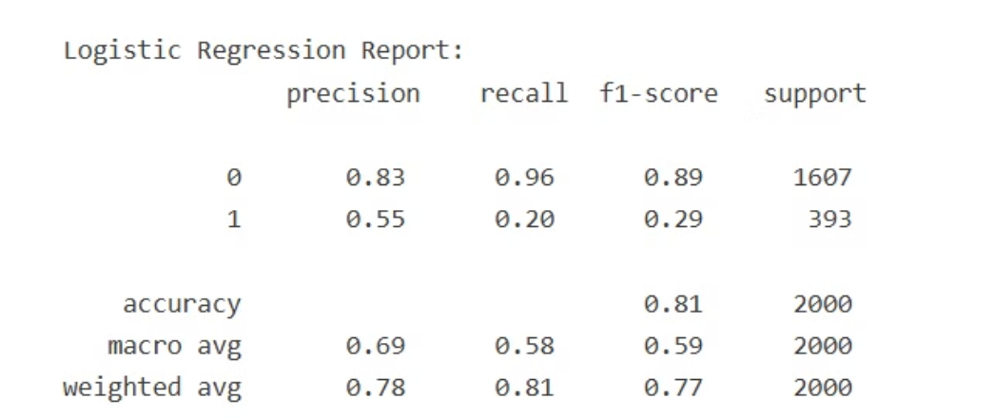
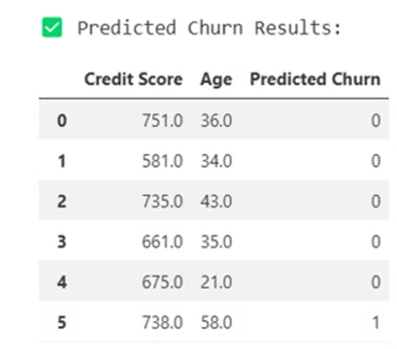
Model Performance (Logistic Regression)
Classification Report
Final Churn Prediction & Model Validation

Slide 10
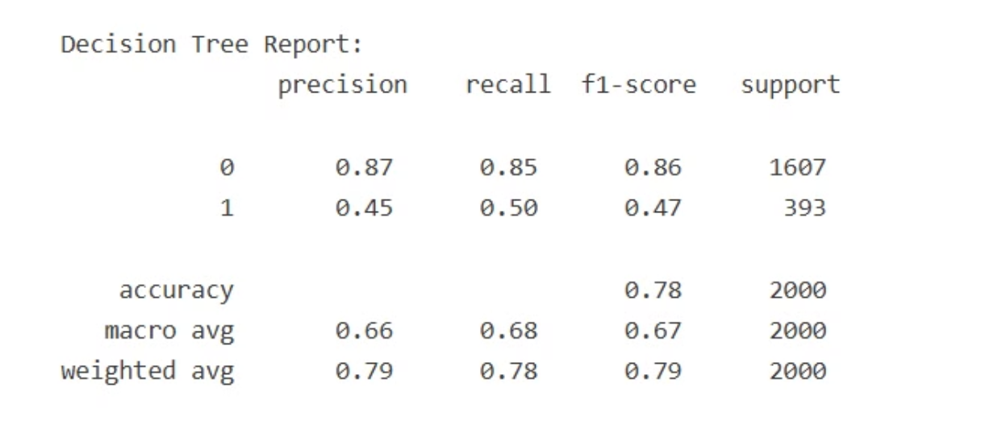
Decision Tree Classification Report

Slide 11
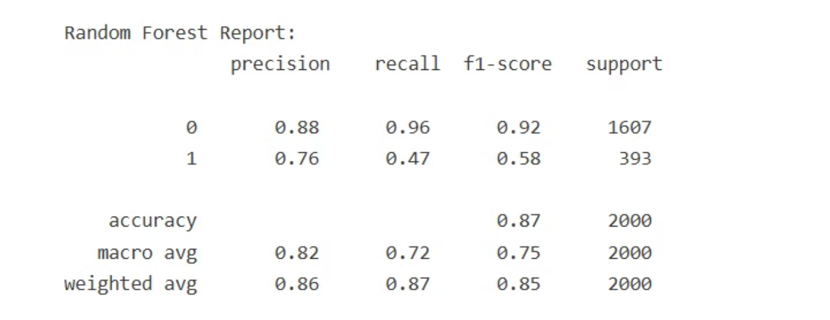
Random Forrest Classification Report

Slide 12
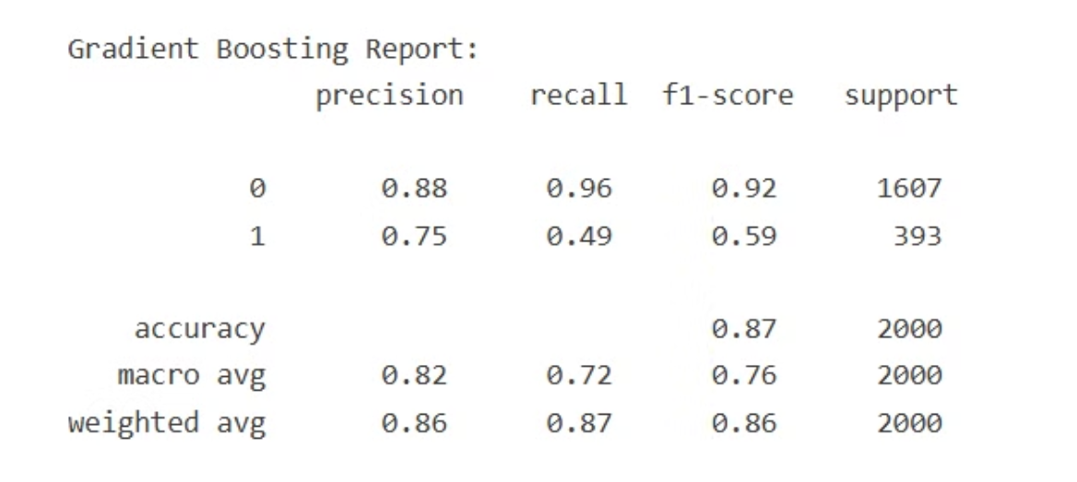
Gradient Boosting Classification Report

Slide 13
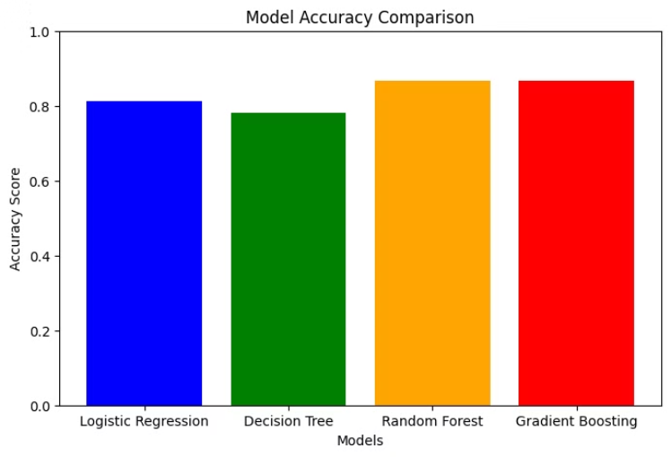
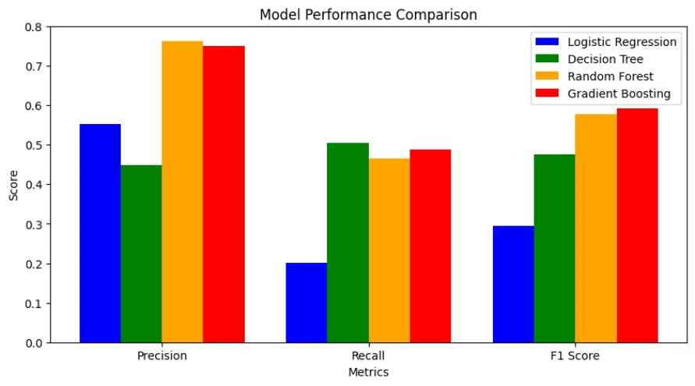
Model Comparison
Model Accuracy Comparison
Model Performance Comparison

Slide 14
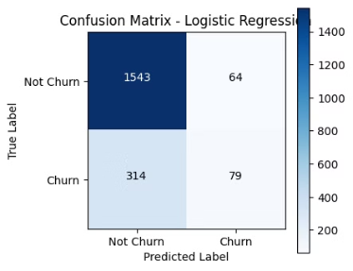
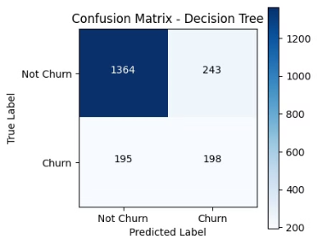


Confusion Matrix

Slide 15




Key Visualizations & Insights
Higher Balances
1
More Products
Churned customers moved funds.
2
Lower churn rates.
Credit Score
4
Active Membership
3
Minimal impact on churn.
Significantly reduces churn.

Slide 16
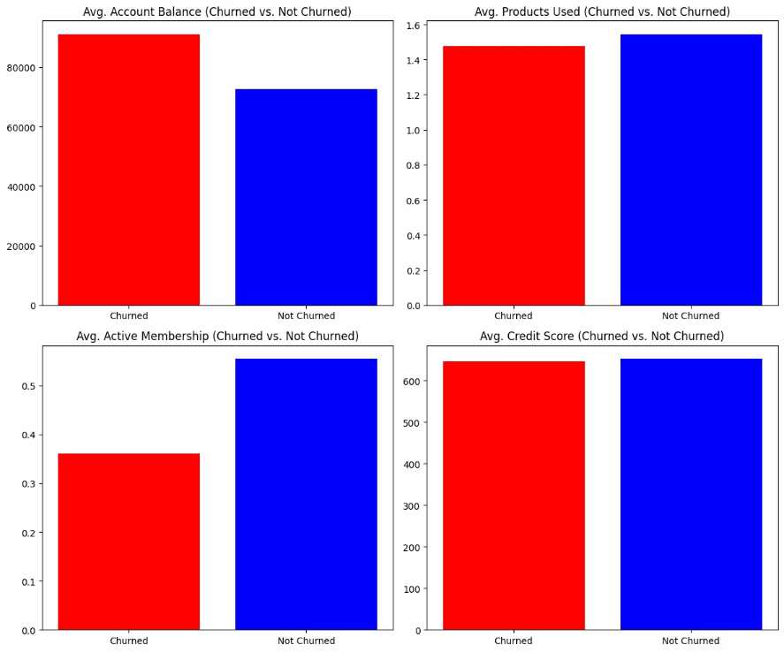
Hypothesis Testing Results

Slide 17



Business Implications
1
Personalized Services
2
Product Bundling
3
Active Membership
Increase active membership, encourage product bundling, improve personalized services.

Slide 18




Conclusion & Future Work
Early Detection
Service Personalization
Future Work
Machine learning enables early detection.
Implement real-time prediction models, RNN, GNN, AI (XAI)
Focus on service personalization.

Slide 19
References
Datrics AI. (2023). Bank churn prediction using ML to retain customers. https://www.datrics.ai/articles/bank-churn-prediction-using-ml-to-retain-customers
Pahul Preet Singh & Fahim Islam Anik (2023), Investigating customer churn in banking: a machine learning approach and visualization app for data science and management https://www.sciencedirect.com/science/article/pii/S2666764923000401
Hoang Tran (2023), Customer Churn Prediction in the Banking Sector Using Machine Learning-Based Classification Models https://www.ijikm.org/Volume18/IJIKMv18p087-105Tran8783
Keldine Malit (2018), Kaggle - Bank Customer Churn Prediction https://www.kaggle.com/code/kmalit/bank-customer-churn-prediction
Generative Pre-trained Transformer (ChatGpt): For Model Coding
Gamma.AI (For Presentation)

Slide 20



Thank You!
Engage
Questions
Discussion
We appreciate your attention!
Now, I welcome your questions.
Let's discuss further.

